Slide 1




HackOrbit 2025
WE BARE BUGS

Slide 2

THEME
Sustainability and AI & Machine Learning
Problem Statement :
"SolarSmart: Pincode-Based Solar Power Estimation with Intelligent Chatbot Assistance"

Slide 3
PROPOSED SOLUTION
Data Sources: Draws on weather forecast information from NASA and a solar panel data set to use for panel details.
User Input: Receives location, panel watts, number of panels, tilt, and efficiency through an easy-to-use frontend.
Prediction Engine: Merges weather and panel information to forecast daily solar power output (in kWh).
Real-Time Forecasting: Retrieves real-time weather data based on user location for precise predictions.
Scalable Design: Can easily be made to use in various locations and panel configurations.

Slide 4
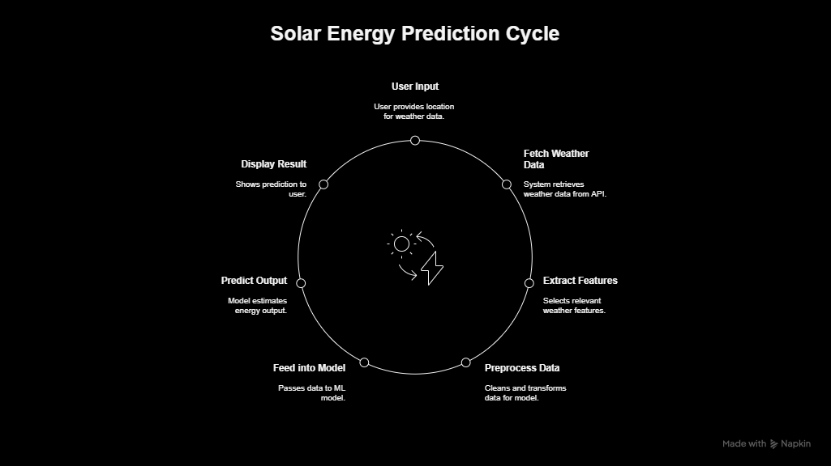
FLOWCHART / DIAGRAM

Slide 5
FLOWCHART / DIAGRAM
1. User Input
The user begins by providing their location through pincode .
This is essential for fetching local weather data.
2. Fetch Weather Data
Then the system calls an external weather API; NASA POWER.
It takes with it both raw irradiance data and some more parametric that influence this solar energy production.
3. Extract Features
Only those features that are needed for predicting energy are selected from raw weather data.
Those are the parameters which contribute to solar power generation directly (like sunlight hours, irradiance and cloud cover).
4. Preprocess Data
The selected features are associated, cleaned and transformed.
This involves doing things like addressmiting missing value's, converting units to some standard
scale, convert columns into the format that model can interpret in the future code.

Slide 6
FLOWCHART / DIAGRAM
5. Feed into Model
Provide Inputs to Model Data that has been processed is passed through a ML model that is trained on historical weather + energy generation datasets.
The ML model was designed to take inputs like weather data etc and come up with a predictive estimation
6. Output of Prediction
The ML model estimates the total solar energy in kilowatt hours (kWh) that will be gained that day.
7. Display Results
The Predicted Energy output is displayed to the user via the User interface.

Slide 7
FEATURES AND NOVELTY
Pincode-Based Estimation: Users enter their pincode of area for hyper-localized predictions of solar power.
Real-Time Weather Integration: Live weather data affects the output, increasing precision over static estimates.
Custom Panel Inputs: Users set solar panel area and type (company/material) for customized results.
Interactive Chatbot Assistance: Integrated FAQ chatbot provides answers to typical solar-related questions, enhancing user experience.
Clean Web Interface: HTML/CSS/Java-powered front end provides an intuitive and responsive interface.

Slide 8
DRAWBACK AND SHOWSTOPPERS
Weather API Dependency: The system relies heavily on third-party weather APIs, which may have rate limits, costs, or availability issues.
Data Granularity: Pincode-level location data can’t always reflect localized factors like shading, terrain, or roof tilt, affecting estimation accuracy.
No Real-World Feedback Loop: Without integration with actual solar panel sensors or IoT devices, output remains theoretical rather than measured.
Chatbot Scope Constraints: An FAQ-style bot can feel rigid if users ask questions outside its scripted dataset, reducing its perceived intelligence.
UX and Privacy Risks: If front-end isn’t optimized for all devices and proper validation isn’t in place, accessibility and data privacy could be compromised.

Slide 9
WE BARE BUGS
Name of team members and their contact details
Sr no. | Name of Team Member | Email Address | Phone no
1) | Sarvesh Santosh Sapkal | sarvesh.sapkal24@vit.edu | 9860039768
2) | Shalvi Viny Maheshwari | shalvi.maheshwari24@vit.edu | 8669881079
3) | Laukika Mukund Shinde | laukika.shinde24@vit.edu | 9309344314

Slide 10
Thank you!

